Slide 1

Do Your Best!
Lesson Planning
Guide

Slide 3
Contents
DYB Lesson Planning Guide
Lesson Planning | 1 | □
Types of Lessons | 2 | □
Lesson Structure | 3 | □
Lesson Template | 4 | □
Example Lesson | 10 | □
Initial Steps | 20 | □
Planning Assignment Schedule | 21 | □
Brainstorming | 22 | □
Linking & Scaffolding | 23 | □
Production Activities & Interactions | 24 | □
Formatting | 25 | □
Resources | 28 | □
Teaching Differences | 29 | □
Teacher Pages & Adaptability | 30 | □
Review Process | 31 | □

Slide 5
Lesson Planning
What is Lesson Planning?
At DYB, we have the freedom and flexibility of teaching our own lesson plans made those of other Native English Teachers (NETs). Our lessons are based on the students’ reading boo topics covered by Korean Teachers (KTs).
Each week, NETs create a lesson assigned according to the lesson planning schedule. These lessons are then shared on Dropbox for all NETs to use. We aim to offer a selection of lessons for each unit to provide options for each class.
Aims
NET classes, and therefore our content, should link back to the unit read with the Korean teacher.
KT classes focus on the receptive skills, listening and reading, along with teaching grammar and vocabulary. As such, grammar does not need to be the sole focus of our lessons. Our aim is to have students speak or write freely using target language at the end of the class. This can be supported with a grammar point, but it doesn’t have to be the key focus. A good lesson should aim for the following:
Enjoyable content that has significant educational value.
Challenge students to use the reading book unit topic and lesson target skill in accordance with the DYB Circular System.
Refer to page 3 of the DYB Training Book
Active participation and interaction between students.
Frequent and equal opportunities to use English.
Benefits
Weekly lesson creation ensures fresh, relevant content along with continuous improvements in quality. By creating our own lessons, we can tailor the content and difficulty to best suit our students’ needs and have the flexibility to adjust and adapt lessons for our own classes.
The lesson creation process helps us to improve as teachers as we can reflect on our classes consider what our students need and how they responded to content. Always reflect on your lesson and consider what went well and how it could be improved. Exposure to other teachers’ lessons can help improve our own lesson creation and classroom outcomes.
1

Slide 6
Lesson Types
Types of NET Lessons
Lessons fall into the following categories:
Speaking – A speaking lesson should aim to have students speaking freely about the unit topic and using the target language. A reduction in the amount students are expected to write should be noticeable in this type of lesson.
Writing –
Writing Lesson– A writing lesson should aim to have students writing in some format based on the topic they studied and using the target language. Writing can take place on worksheets, the whiteboard, on mini whiteboards, or poster paper.
Essay Writing – Every two weeks, students have an essay lesson to assist with essay writing skills and idea formation for their online essays.
For elementary, we use our NET essay workbooks. For middle school, we create essay lessons.
Skill & Event Lessons – Skill lessons are not based on a reading book. These are usually taught in the first week of the semester to give the Korean teacher the opportunity to read the first unit of the book with the students before we teach a lesson based on it. Event lessons are based around upcoming holidays or events.
Lesson Structure
On the next page, there is the detailed overview of the structure of a DYB lesson. This should be followed making a lesson. Consider the purpose of each section, how it links to the sections before and after it, and how long each section should take as a percentage of the total class time (50 minutes).
As with everything, there is flexibility, and it is best to be overprepared rather than underprepared. Class size, ability, and engagement can vary between days of the week, co-teachers, and campuses. As such, content will likely need to be adjusted by each individual teacher to best suit their classes. Please keep this in mind when creating lessons, as other teachers at DYB are relying on your lessons and being able to easily adapt them.
For example, some classes may only need two practices to show full comprehension of the target language. However, other classes may require a third practice to better understand and to be ready for the production activity. As teachers, we have the autonomy and flexibility to adjust lessons as needed either before, during, or after the class.
2

Slide 7
Lesson Structure
Lesson Structure
A good lesson is one that flows, is formatted well, and is uncluttered. Simple and relatable examples should be used and lessons should link back to the unit often. Our lessons should not only help students learn, but enjoy learning.
Pre-Lesson Engagement (PLE) (10%)
Discussion Questions
Discussion questions to help elicit ideas about the topic.
Vocabulary
Review important topic vocabulary words, these words will be used in the comprehension questions or during the lesson, so a quick recap is useful.
Turn this into a simple game or activity to engage the students.
Comprehension Questions
Four or five comprehension questions to check the students’ understanding of the topic they studied previously with their Korean teacher.
The PLE is completed verbally and is not included on the PPT
Warm-Up Activity (15%)
This should be a fun and engaging activity that gets the students to subtly start using the skill or vocabulary for the lesson. It can also be useful to check their existing ability.
Practice (25%-35%)
This starts with the teacher driven portion of the class that should involve the most teaching, board work, and working together.
Use scaffolded controlled practices to give students particular speaking or writing skills that are required for the production.
Two or three activities can normally ensure that students have practiced the skill sufficiently.
Guide students, correct mistakes, and give positive reinforcement.
Production (35%-45%)
This is the student driven portion of the class where students use what they learned to independently complete a piece of writing or a speaking exercise.
Try to reduce the teacher focus during this time to allow for maximum language usage by students.
Monitor and guide the students as needed and make note of any errors.
Correct any errors after the exercise.
Closure (5%)
Reinforce the skill taught and discover if you reached your goal of the class.
A quick skill review question can work well.
3

Slide 8
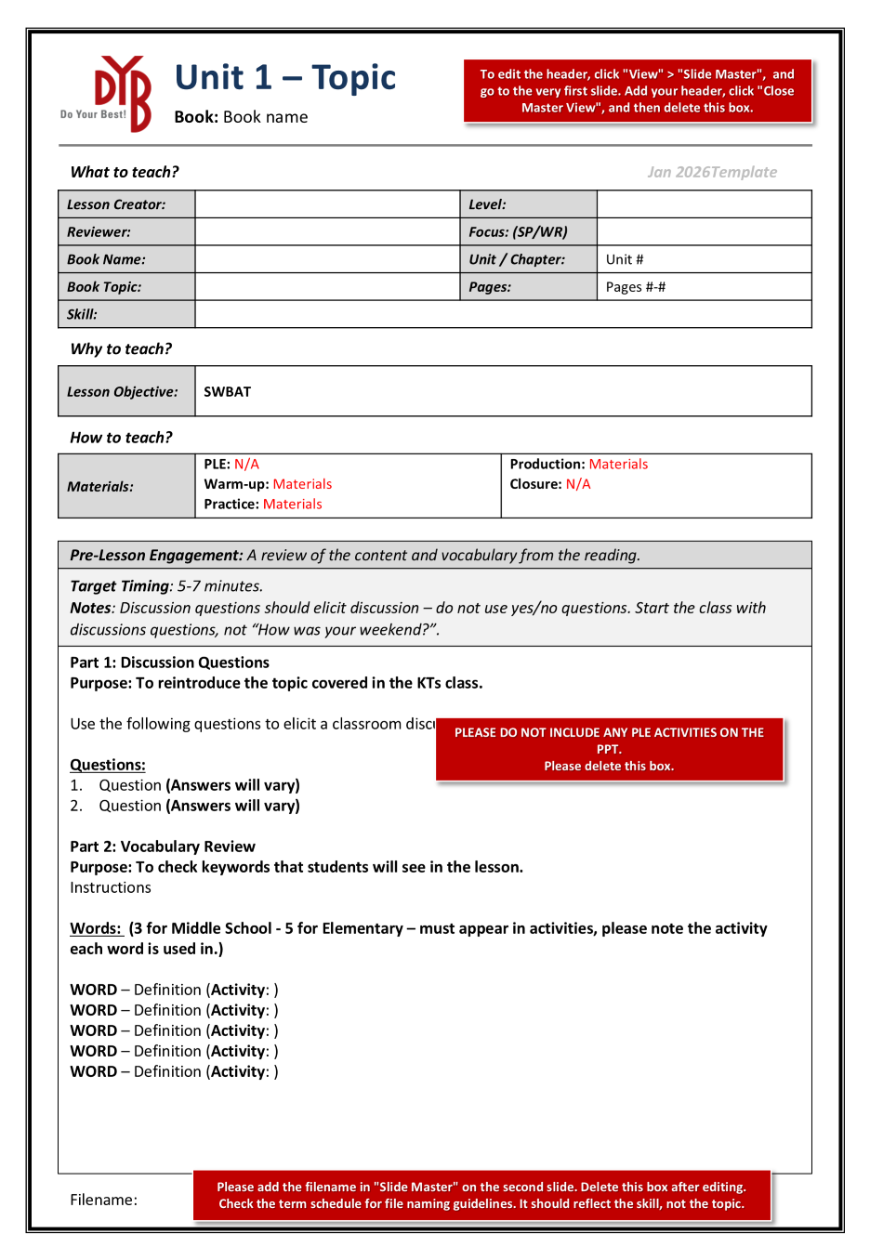
Lesson Template
Below is the standard lesson template for a normal speaking or writing lesson. This template is used for both elementary and middle school lessons. You should already be familiar with these pages from your first few weeks of teaching.
Update the header following the directions box on the template.
Complete the basic information.
Add a clear aim for the lesson.
(SWBAT = Students will be able to …)
What materials are needed. (Worksheets, dice, coloring pencils, etc.)
Detailed purpose statements, teaching directions / notes, and answers for each section of the lesson. Alternative teaching approaches could be included. Remember, other teachers rely on these to teach your lesson!
Follow the directions to add the filename.
4

Slide 9
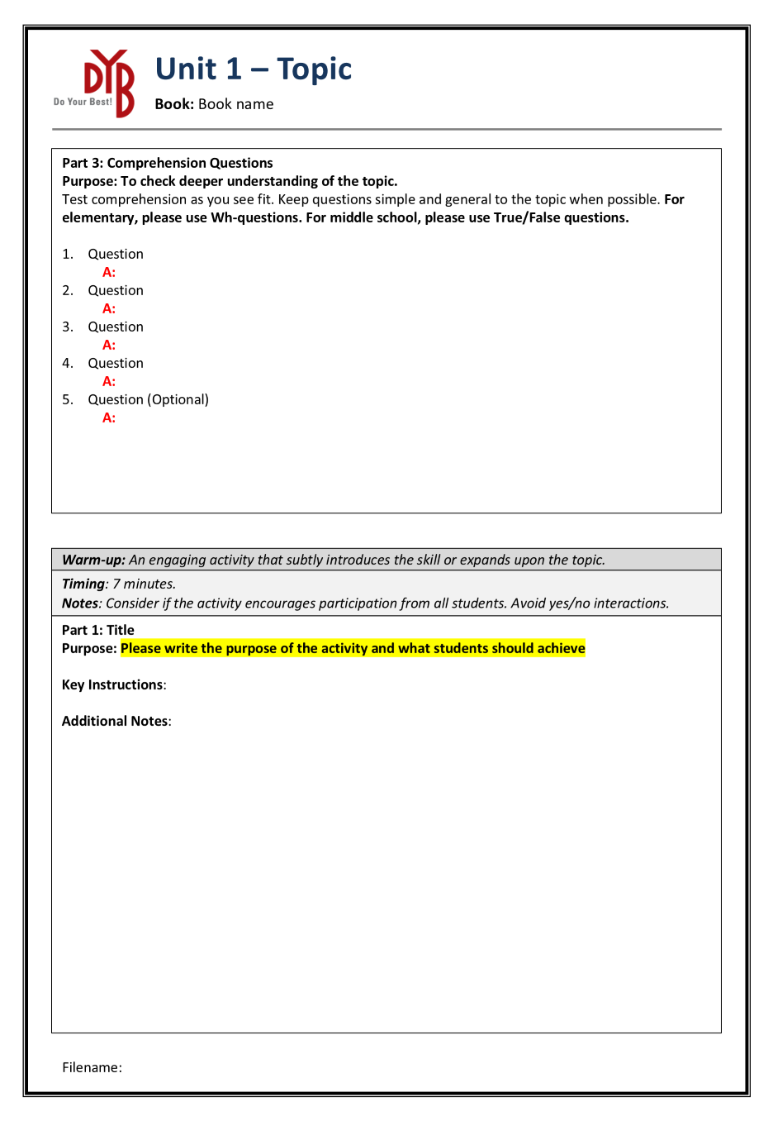
Lesson Template
This will automatically update for all the pages after you do it on the first page.
Continued notes about the Pre-Lesson Engagement section.
Approximate timings are also given. (These timings follow the percentage breakdown for a 50 minute lesson)
Teaching notes for the Warm-up section. If more space is needed, you can create a new page.
For the rest of the teacher pages, you will need to complete the purpose statements yourself. This is not what to do, but WHY students are doing it. What is the desired outcome of the activity?
5

Slide 10
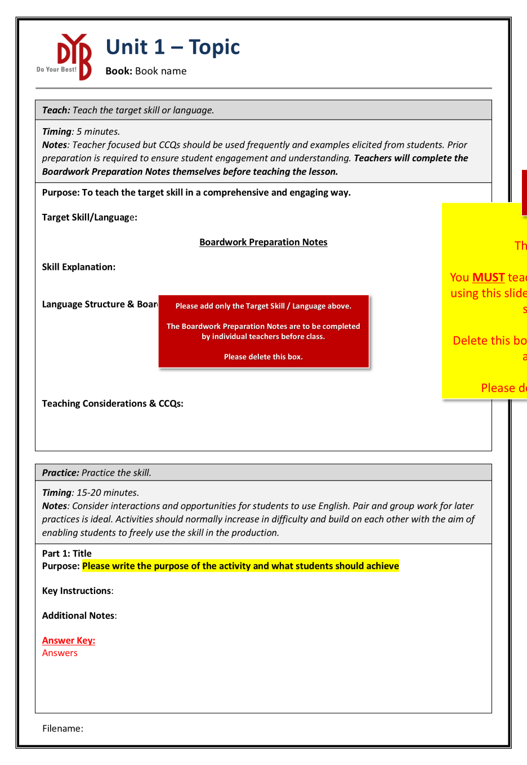
Lesson Template
Important reminders for each section of the lesson are included under “Notes”.
Only the Target Skill / Language section needs to be completed by the lesson planner.
Boardwork Preparation Notes are for teachers to complete before class.
The yellow box should be placed over any teaching review slide on the lesson (PPT). It is included in the (DOC) template for convenience
Refer to the example lesson PPT.
6

Slide 11
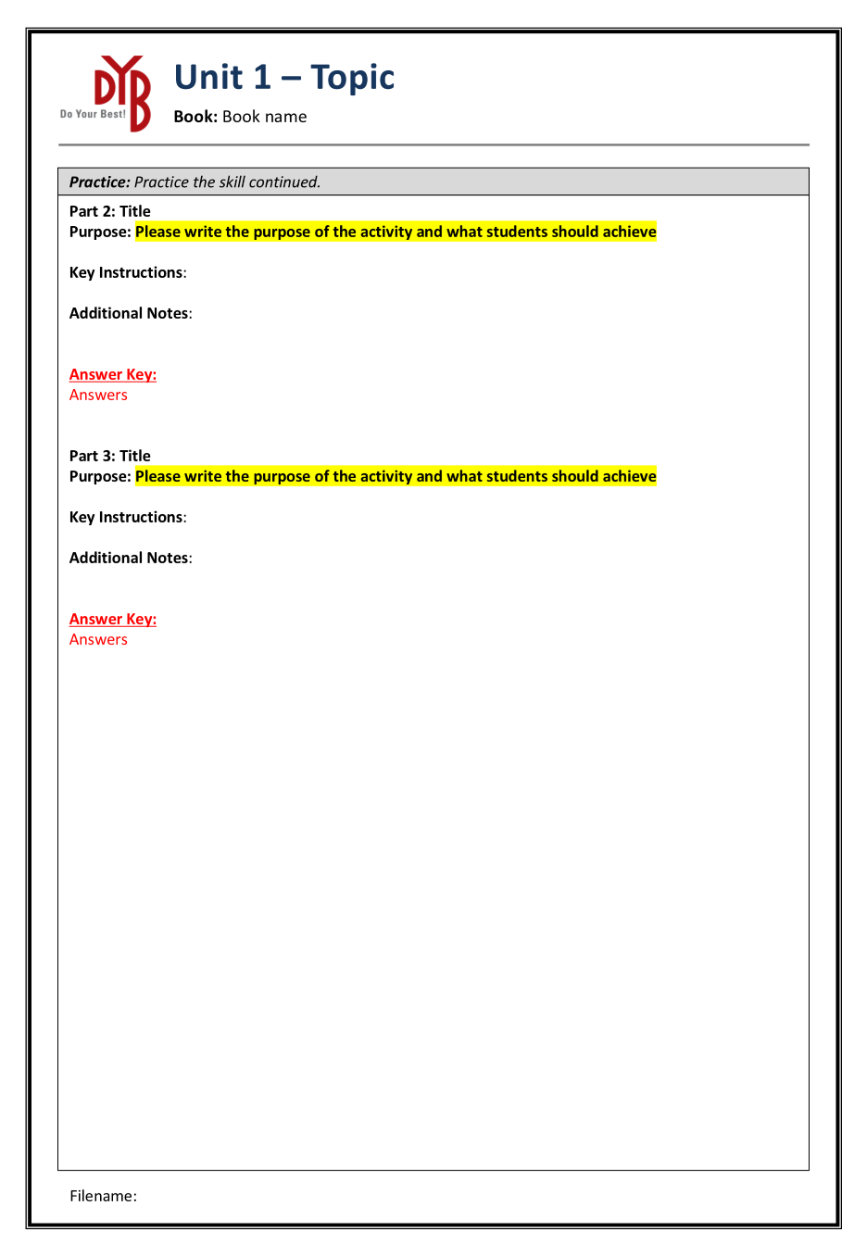
Lesson Template
Key Instructions should be simple one sentence explanations. More detailed instructions or considerations can be provided under Additional Notes.
You can add or remove parts for each section as needed.
The rest of the teacher pages follow the same format.
7

Slide 12
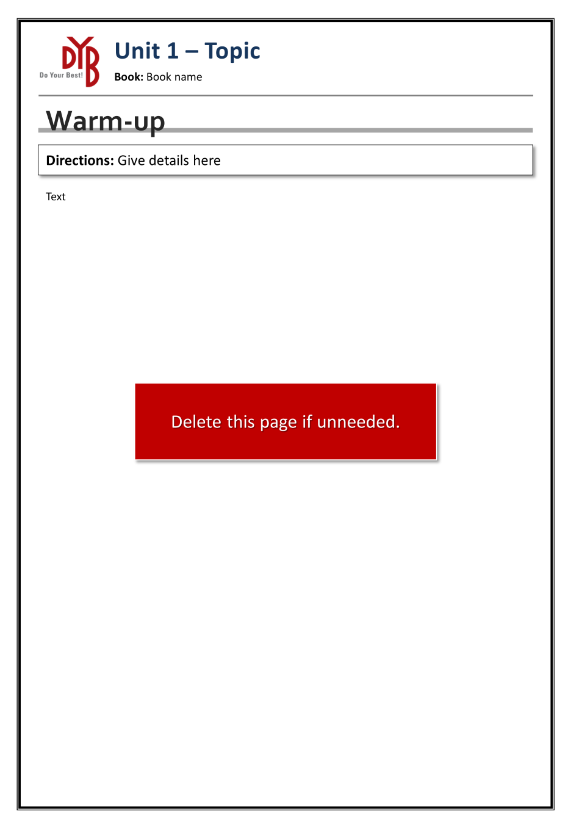
Lesson Template
For the student worksheets, you can delete pages if they are not required. However, please ensure that you have at least 1-2 pages of worksheets for students. Worksheets are needed so that students can practice on paper, students have materials to reference, and also so that parents can see what they have done in our class time.
An instruction / directions box.
Ensure that instructions are simple so that all students can understand easily.
8

Slide 13
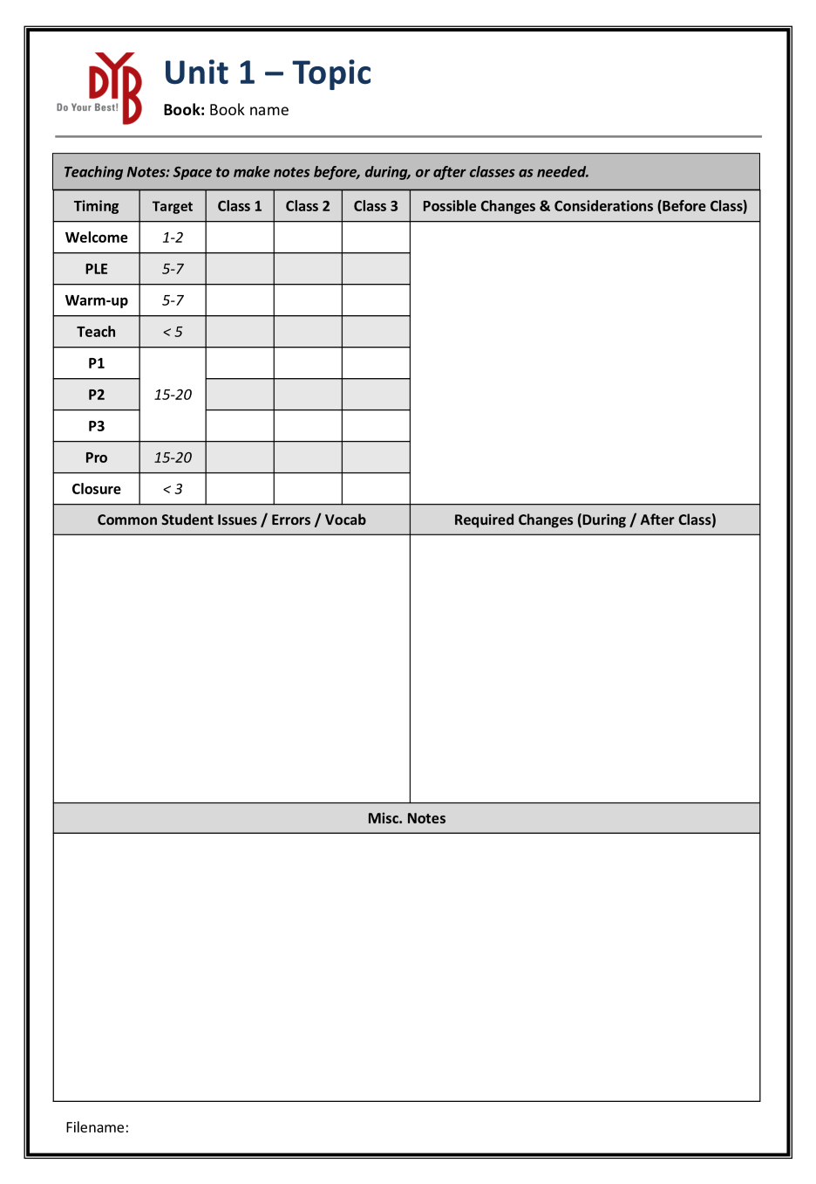
Lesson Template
This Teaching Notes page is included at the end of the instruction pages and are left blank for the teachers to make use for class preparation and for notes required during the class. Nothing is required on this page for lesson planning, please make us of it in your classes though!
9

Slide 14

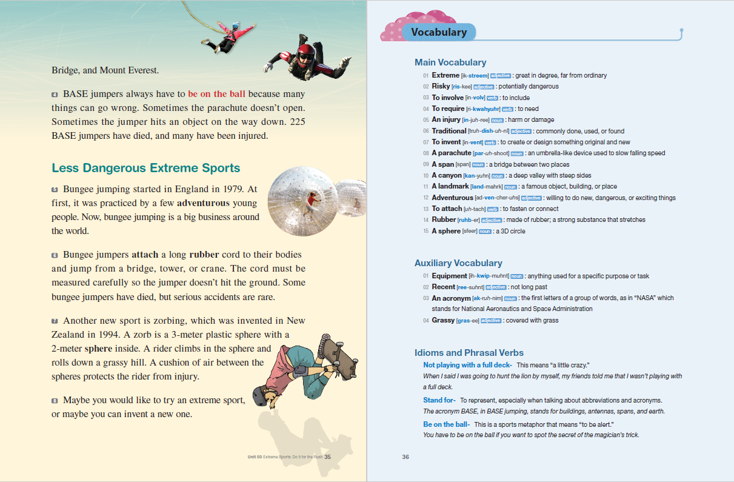
Example Lesson
Below is an example of a reading that the students may complete. When teaching our classes, we should be aiming for students to use key vocabulary and themes from the reading.
On the following pages, you will find a lesson made for this unit. The lesson consists of the teacher pages, the student worksheets, and a corresponding PPT.
This is a speaking lesson made for the Basic & Beginner levels of Grade 6 (Helios & Poseidon).
10

Slide 15
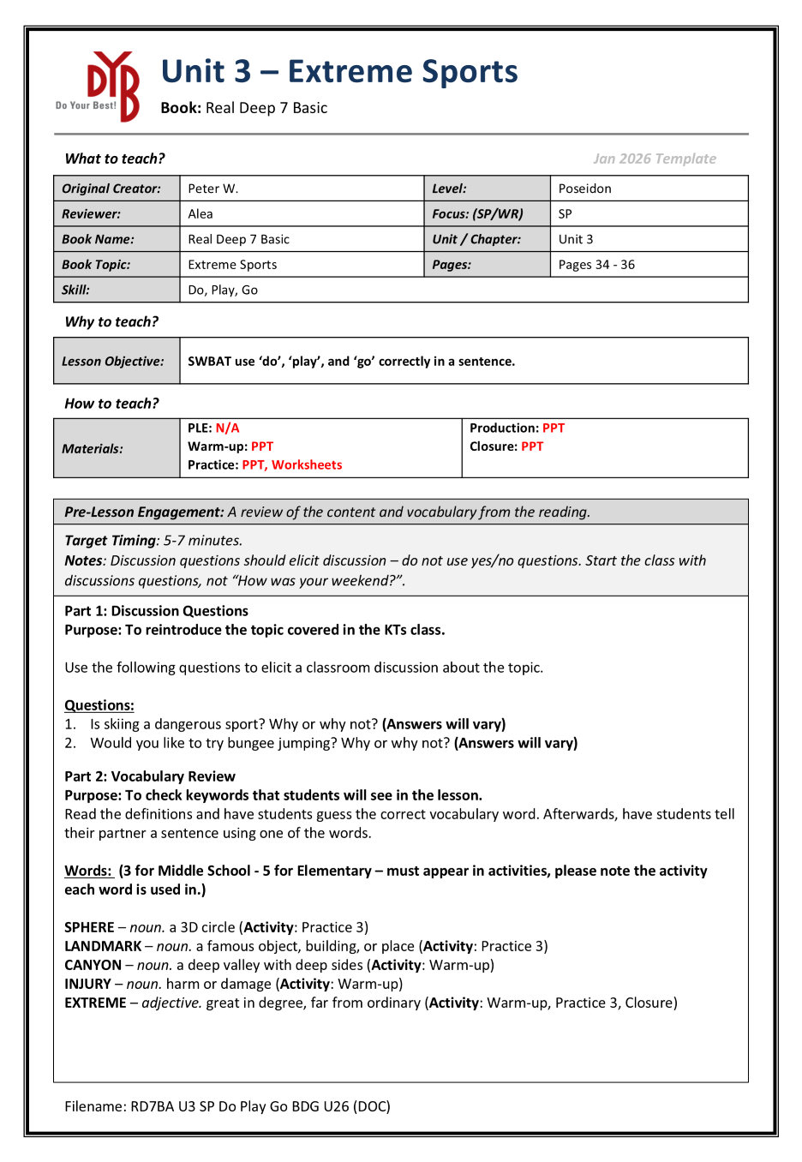
Example Lesson
SWBAT – Students will be able to …
11

Slide 16
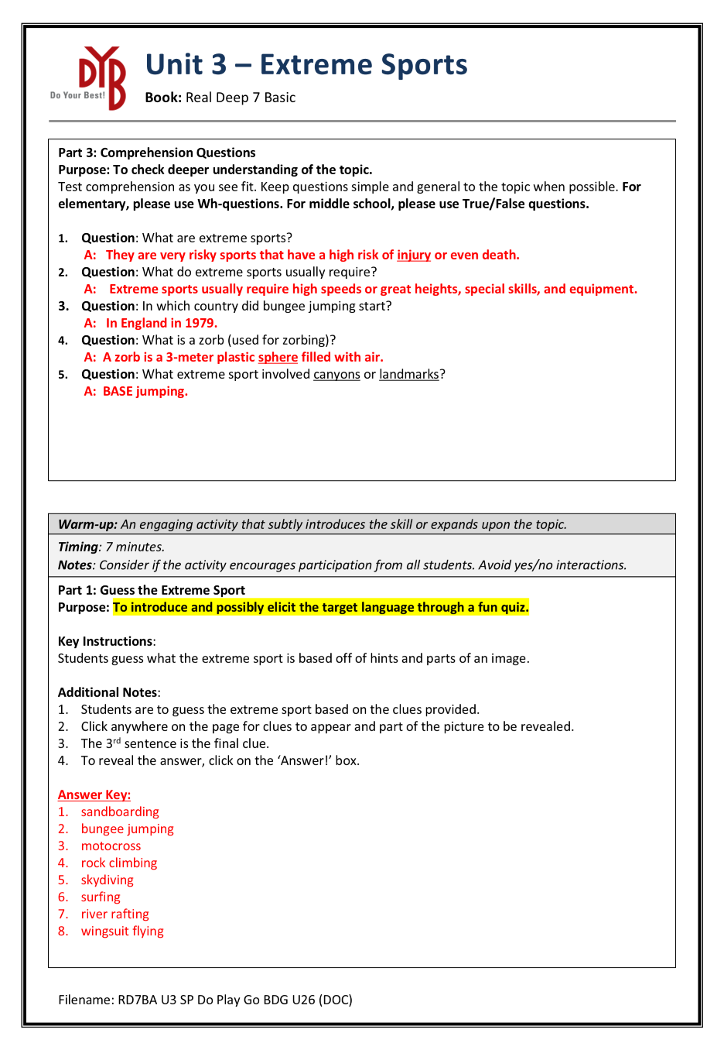
Example Lesson
12

Slide 17
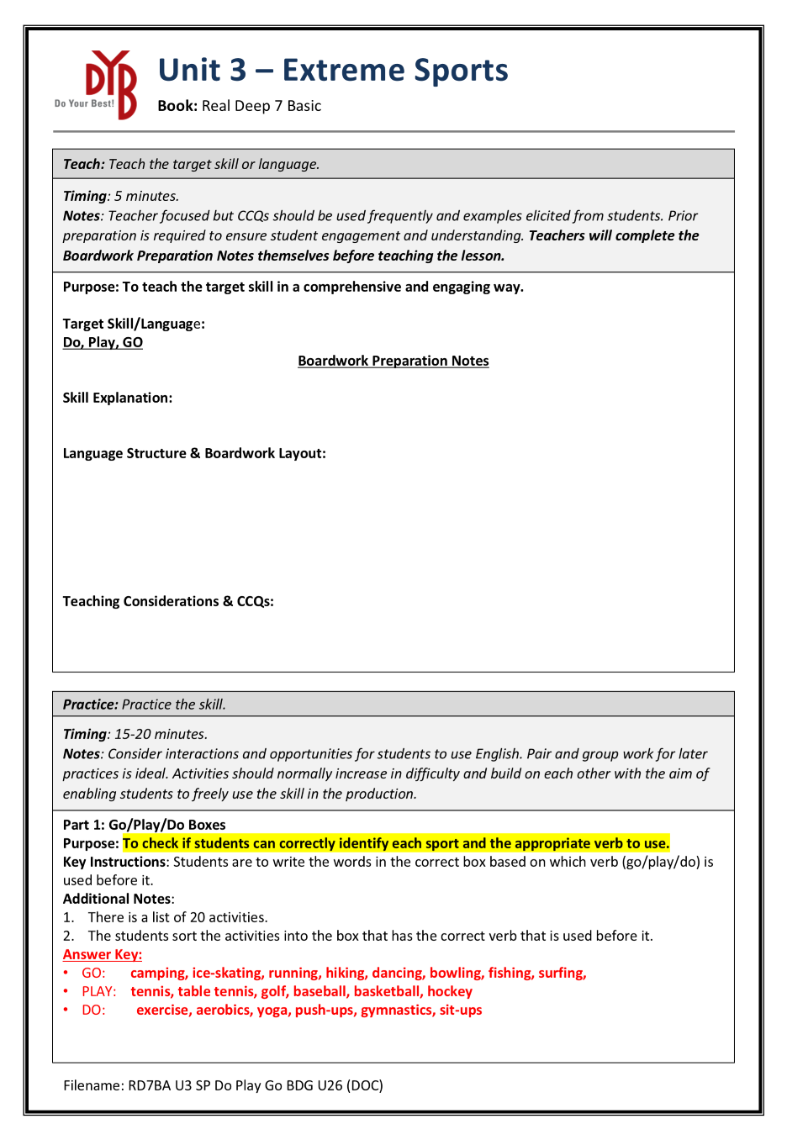
Example Lesson
13

Slide 18
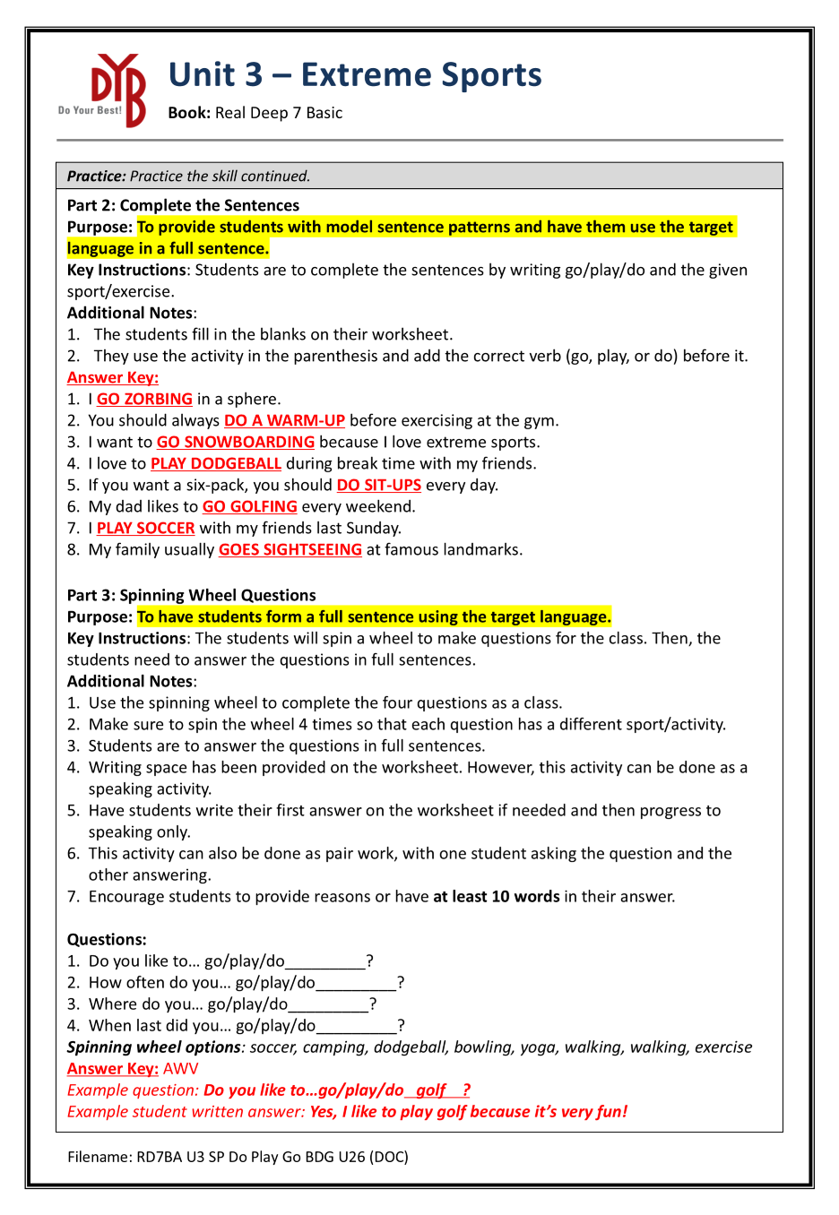
Example Lesson
14

Slide 19
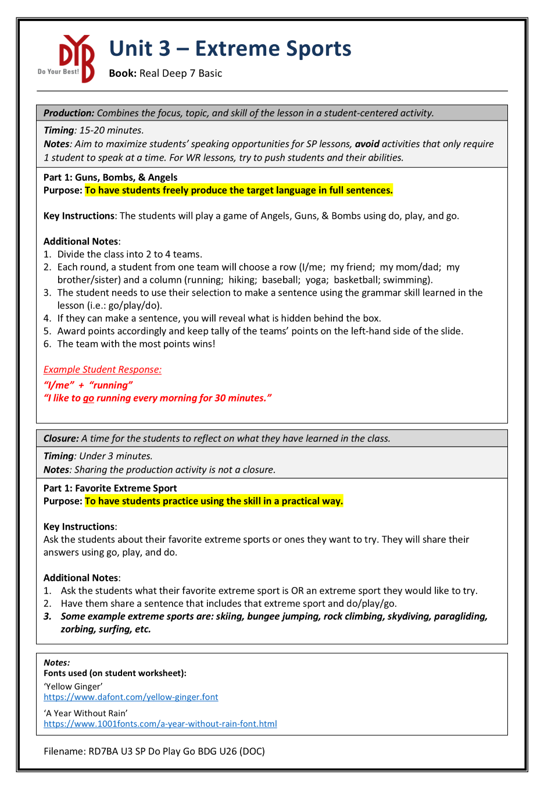
Example Lesson
15

Slide 20
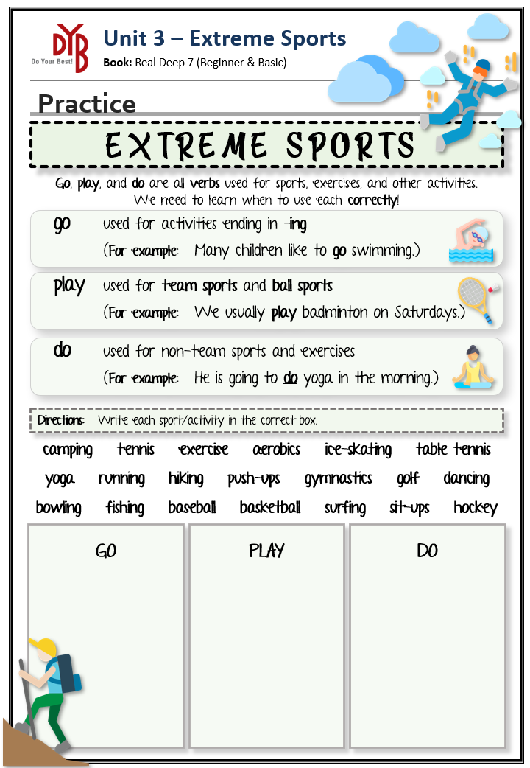
Example Lesson
16

Slide 21
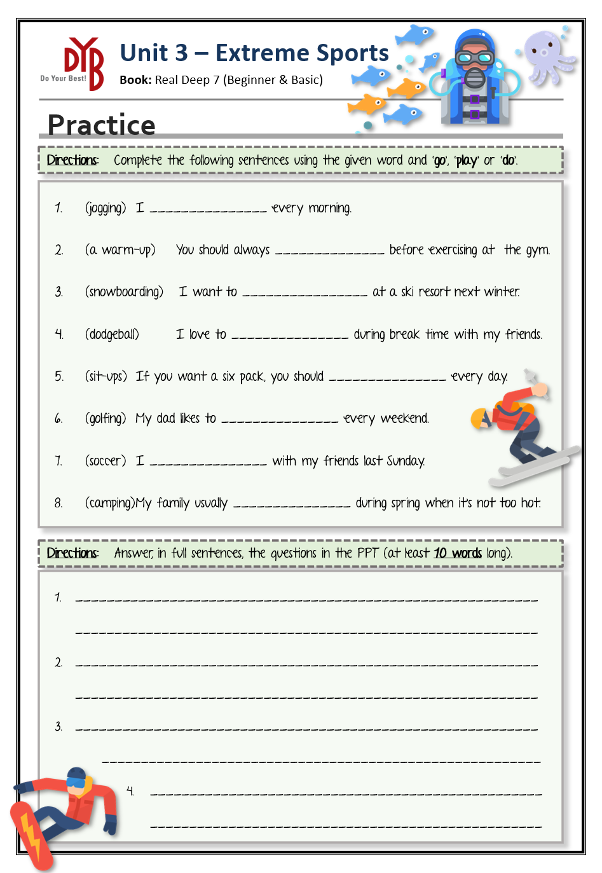
Example Lesson
17

Slide 22


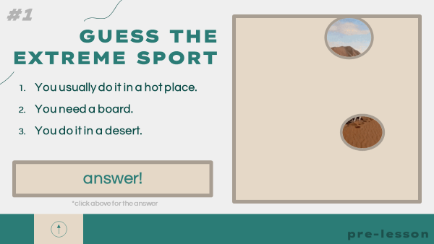
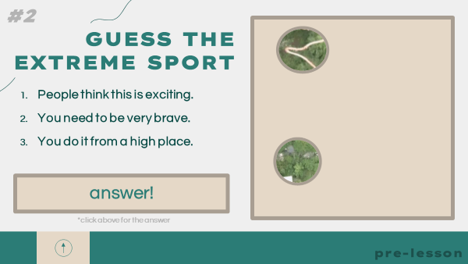
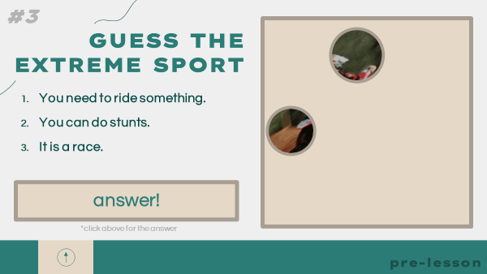
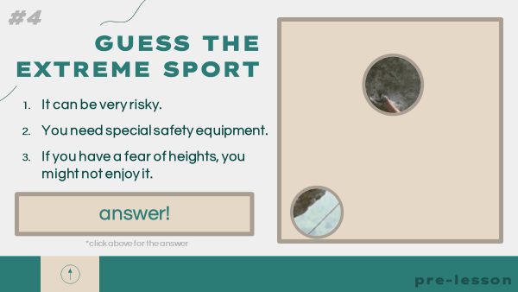

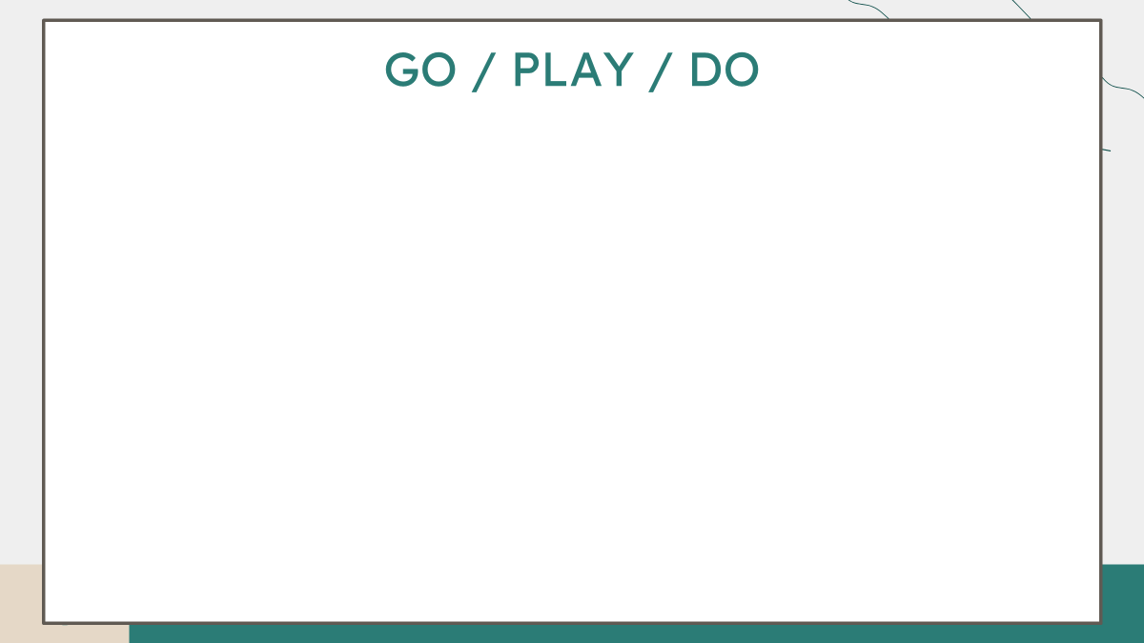
Example Lesson
All answers are animated to reveal when clicked.
Used to teach the target language using the whiteboard
18

Slide 23
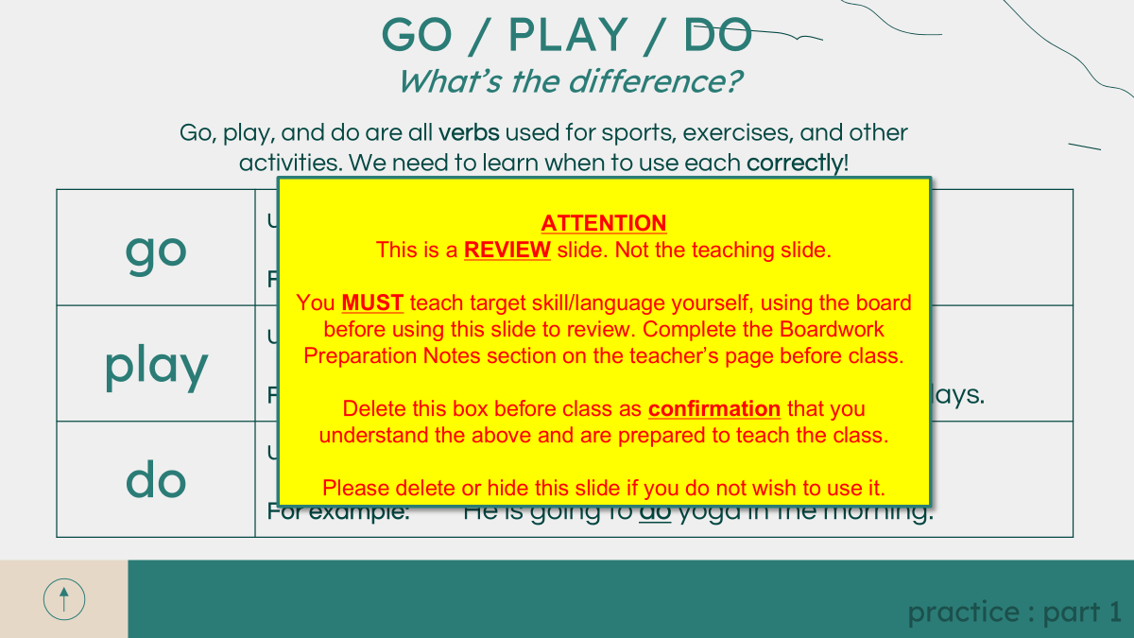
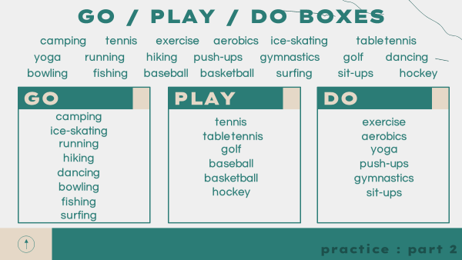
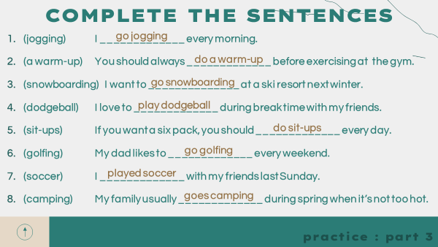
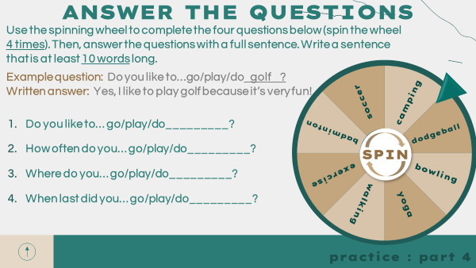
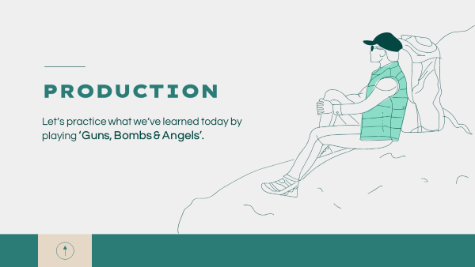
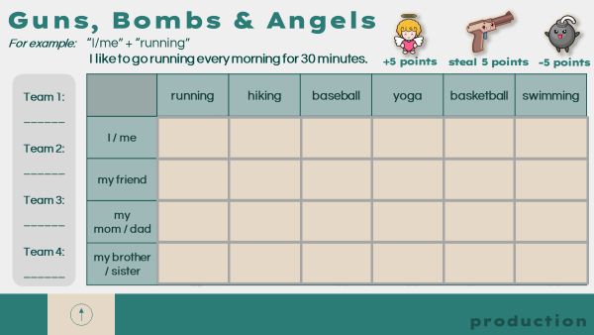

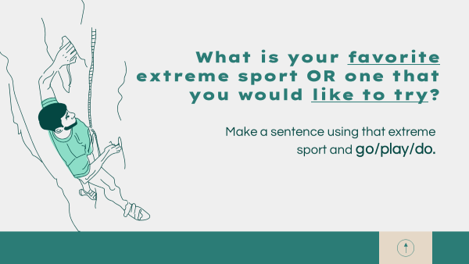
Example Lesson
Target language review slide with warning message. Hidden & optional.
Clicking on the wheel makes it start or stop spinning.
Clicking on a square reveals a gun, bomb or angel.
19

Slide 24
Initial Steps
Initial Steps
Making your first lesson can be a daunting and time-consuming task. Here are some steps to follow to help you. Please remember that your team leader and team members are there to help you. Do not hesitate or be afraid to ask for help and ideas.
Ask your team leader for your planning schedule. It can also be found on Dropbox in the “Term Schedule” folder.
Check which lesson you have been assigned for the next upload and check which book is needed. Be sure to check the book edition / publication year.
Check recent lesson uploads for that level on Dropbox to see what skills / grammar points have been covered recently or will be taught in upcoming weeks.
Read the unit in the book and identify the main topic / ideas.
Start brainstorming ideas for the lesson. (Check the brainstorming section for more information.) Brainstorming is normally completed during the weekly team meeting.
Once you have decided on an idea, scaffold the lesson on paper. It is important to identify potential problems early to save time and energy later.
Check that each section builds on the previous, flows well, and leads into the production. Remember that the practice sections should work to enable students to freely produce the target language in the production.
Consider what the balance will be between the worksheets and PPTs and how students will interact with the lesson.
Once you have the lesson scaffolded on paper, start working on the teacher pages and worksheets.
The worksheets are your limiting factor for space/content. The PPT can be used in tandem with the worksheets to provide additional information and content.
Find an appropriate PPT template and make the PPT. (This could be done at the same time as the worksheets.)
Ensure that the worksheets and PPT match up and work well together. Students should be able to recognize the content easily. (See the formatting section for help.)
Prepare your lesson for peer review, team leader review, and coordinator feedback. (See the review process section.)
20

Slide 25
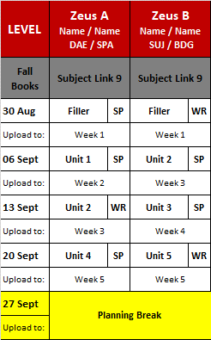

Planning Assignment Schedule
Planning Assignment Schedule
As mentioned in the Initial Steps section, you will find your assigned lesson to make in the planning assignment schedule. This document is made each semester by the Elementary and Middle School Coordinators. It is available in the Term Schedule folder on Dropbox, and your team leader will give it to you when it is ready.
Each level has A and B planners. The names of the planners and their campus are shown below.
The book for the semester.
The lesson’s due date.
The week of the semester in which the lesson will be taught.
The unit of the book the lesson should be based on.
Note: As we have A & B planners, you will not make lessons for every unit.
Whether the lesson should be speaking or writing focused.
Plan Ahead
No lesson due.
Note: Plan ahead weeks are normally given around national holidays, DYB events, or busy periods. They are given for you to work ahead on your lessons, make use of the time wisely.
21

Slide 26
Brainstorming
Brainstorming
Brainstorming ideas for a lesson can often be the most difficult step. Below are some approaches for you to consider when doing so. Your team leader and other team members will always be willing to help with ideas, too! Try to think of your main lesson idea as soon as possible. Read the unit beforehand and keep it in the back of your mind. You never know when you might get a bolt of inspiration.
Note: We don’t need to focus on grammar in our lessons, but we can use grammar points as a tool to support our lesson aims. Grammar could be presented as simple sentence patterns for lower levels.
Three Approaches
Production First | Skill First | Needs First
After reading the unit, think about what could be a good production activity. Then, consider what skill(s) students will need in order to complete the production successfully. These will be the focus of your practices. | After reading the unit, is there a specific grammar point that would work well? If so, is there a production that would allow students to freely use the grammar point? | Is there a common mistake that students in your class make? Check your lesson planning schedule and the unit topics. Is there a unit that would work well with the grammar point?
Example: The unit topic is about desserts. Production: Create a Recipe Skills Needed: -Cooking Verbs -Cooking Adjectives -Imperatives -Sequencing (Low levels might focus on one of these skills, whereas high levels could do more than one.) | Example: The unit topic is about extreme sports. Skill: Sport Verbs Consider: Can I make an appropriate production that allows students to freely produce the target skill? Some skills might not work depending on whether you're making a Speaking or a Writing lesson. | Example: Students struggle with the past tense. Look ahead on your planning schedule for a unit that would be suitable for the skill. Unit 3 – Desserts Unit 4 – Animal Defenses Unit 5 – Gender Differences Unit 6 – Galileo Unit 7 – Disgust Unit 8 - Ghosts
22

Slide 27
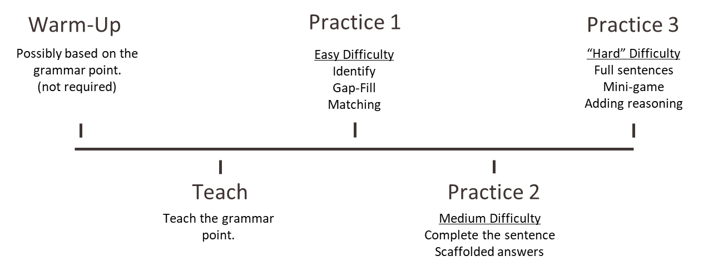
Linking & Scaffolding
Linking
Each activity should fit cohesively into the lesson and help the overall flow. A good way to do this is to consider how to link activities together.
Warm-Up Activity
Refer back later
A variation of the activity can be done again after learning the target language. They can learn the activity with simple expectations and then do it again with higher expectations of specific language use.
Plant seeds
It could introduce examples or information required later in the lessons. (Example: If students need to write about a famous person, the warm-up could be guessing famous people based on their achievements, etc.)
Vocabulary & Book Information
Unit vocabulary throughout
If we are reviewing the vocabulary at the start of the lesson, we should also include it throughout the lesson! Use key vocab words in examples, in questions, or in work banks. Try to encourage students to use the word when possible.
Sentences and tasks inspiration
Examples and questions for activities can come from the book. Again, try to encourage the use of the Circular System and what they have learned with our co-teachers.
Scaffolding
For most lessons, the activities should not only flow well but also increase in difficultly leading into the production. Below is a suggested scaffolding structure. See the example lesson in this guide to see how this looks in practice.
23

Slide 28
Productions & Interactions
Production Activities
The production activity should allow students to freely apply what they have learned. Try to make the production activity open-ended and creative.
Speaking | Writing
Encourage as much speaking from as many students as possible. Games (consider interactions) Students speaking to each other Group work Movement in the classroom Making short notes if needed Avoid Writing and then reading Writing heavy worksheets Team games with just 1 student speaking | The focus should be on writing, but it doesn’t need to be silent! Individually or as a group Short or long form Use varied media Game based Consider providing structure for low levels Avoid Sharing to the class Drawing with no writing
Interactions
For each part of your lesson, consider the interactions which will happen in the classroom. Try to maximize the number of opportunities, and therefore, time that students are using English.
Teacher | Teacher - Student | Student - Student
The teacher is the focus of attention. Explanations Lecturing Reading Design your lesson to avoid lots of lecturing or unnecessary explaining by the teacher. Try to limit | The teacher is interacting with students. Checking / Sharing Small talk Some games Try to avoid designing activities that include a lot of this. It is limiting in larger classes. Try to limit | Students are interacting with other students. Pairwork Group work Discussions This maximizes English usage. Move away from the PPT and have group activities. Try to maximize
24

Slide 29
Formatting
Formatting
Formatting is an important aspect of lesson planning. Bad formatting can ruin an otherwise great lesson!
Students should be engaged by the material.
The PPT and worksheets should be easy to understand.
The overall legibility of the PPT and worksheets.
Space is used efficiently.
Parents see worksheets.
We use PowerPoint for both the lesson PPT and worksheets. This helps simplify the formatting process and allows for transfer of content between the worksheets and the PPT.
Please watch the basic formatting tips video in the training folder if needed. Your team is always there to help you if needed and can they solve most PPT problems/queries easily.
Worksheet Formatting
Please refer to the example lesson worksheets on pages 12-13 for example worksheet formatting.
Consider the following when creating your lesson worksheets:
Instructions should be formatted clearly and be simple for students to understand.
All information students need to complete the activity is provided first.
Don’t put a word bank below the writing space.
Worksheets should be formatted consistently across the lesson.
Font type & sizes. (Use one font size for titles and another for all text.)
Text boxes and shapes.
There are clear divisions between activities. (This can be done with direction boxes / titles.)
An appropriate amount of writing space has been provided for answers.
A note taking box may be more appropriate than lines for some activities.
Questions can be added or removed to best fit the space available.
The worksheets match the PPT. You can copy between them and reformat as needed.
Copy & paste as a text box. Do not paste as an image, others cannot edit!
Change the color as needed to ensure visual clarity.
Very light colors and white text boxes should be used due to B&W photocopying.
It is difficult for students to write on dark boxes.
The worksheets should be easy for other teachers to edit.
Images are used well. (To depict keywords & ideas, as decoration, to fill space, etc.)
Ensure that images do not have watermarks. Some are very faint, so check carefully.
25

Slide 30
Formatting
PPT Formatting
Please refer to the example lesson PPT on pages 18-19 for ideal PPT formatting.
There is a video on Dropbox that covers some PPT basics. Please also check YouTube for handy tutorials and ask your team if you have questions or issues!
Consider the following when creating your lesson PPT:
How the PPT will look when projected in the classroom.
There should be a good contrast between the background color and font color.
Light background and dark fonts recommended.
Fonts should be easy to read. Legibility is the most important consideration.
Avoid white fonts. Dark fonts required
Aim to use size 18+ on the PPT.
If using a downloaded PPT template with custom fonts, the font information slide should be easy to see. (A hidden slide at the start of the PPT.)
The PPT attribution slide should also be kept.
Slides should not be overloaded with text / information.
Avoid "stacking” information on one slide, as it is difficult to check & edit.
Use multiple slides.
The PPT should be easy for other teachers to edit.
Avoid downloaded fonts.
Don’t use non-editable images of text.
Use animations as needed, but don’t overuse them.
The PPT can work in conjunction with the worksheets.
Add additional explanations or examples.
Provide images or GIFs to illustrate an example or activity.
Activities may be on the PPT only.
Provide detailed instructions on the teacher pages.
Students should be able to recognize easily how the PPT relates to the worksheets.
Use the PPT to introduce other resources / media.
See the resources page for useful PPT websites (Page 28).
PPT games and interactive features (timers, spinning wheels, etc.) are available online.
26

Slide 31
Formatting
Formatting Example Explained
Direction boxes always have the same formatting, are simple to understand, and keywords are bolded.
Ample space is provided for students to write their answers.
Images are used for decoration and follow a consistent design.
This light green background color photocopies as white.
This section relates to the PPT based activity (slide below). More detailed instructions are provided on the PPT. This could also be done as a speaking activity for stronger classes with no writing required.
Examples can be formatted differently (color, font, italicized, bold).
27

Slide 32
Resources
Resources
Here are some useful websites for lesson creation. You can also talk to your team to find other useful resources.
PPTS
https://slidesgo.com/
https://www.slidescarnival.com/
https://slidesmania.com/
Images & Icons
https://www.flaticon.com/
https://www.freepik.com/
https://storyset.com/
Other
https://games4esl.com/powerpointgames/ ( PPT games)
https://learnenglish.britishcouncil.org/grammar (Grammar)
https://eslgrammar.org/ (Grammar)
https://www.teacherspayteachers.com/ (Lesson inspiration)
https://www.tes.com/teaching-resources (Lesson inspiration)
Activity Database
On Dropbox, you can find example activities and lists of grammar structures for lessons. These can be helpful if you need a source of inspiration.
Other Lessons
We can draw inspiration from other people’s lessons, but we cannot copy lessons. You can use ideas, games, activities, etc. from other lessons, but not the lesson in its entirety, with just a few changes made.
Most games and activities are widely used and can be used freely.
Credit the teacher in the teacher pages if using a unique game or idea.
You can reach out to teachers if you would like permission to reuse their ideas. (Ask your team leader.)
Try to be transformative in your usage of other’s ideas. Adapt the idea to better suit the students’ level and the reading book topic.
Be careful of when the lesson will be taught and to which levels – We should avoid students seeing the same content twice.
If you are unsure about anything, please check with your team leader.
28

Slide 33
Teaching Differences
Teaching Styles
During your initial training period and your ongoing training at your campus, you will have observed many teachers. In doing so, you will have seen many teaching styles and hopefully recognized ones that work best for you. Please keep this in mind when making your own lessons. They will reflect you and your approach teaching, but they also need to be suitable for other teachers and classes.
Consider your teaching style while making a lesson and also how others will use the same content. This might mean adapting your own lesson when you teach it to better suit your teaching style, but ensuring the file uploaded to Dropbox is appropriate for others.
Level Differences
It is important to understand the differences between levels and also variations within the same level. Each semester, students complete a level test, which decides if they level up or remain at the same level.
This test is used across DYB to try to ensure students in the same level are around the same English ability. However, please keep the following in mind.
Some students are new at DYB and may be weaker than their classmates.
At the start of a new semester, new classes of entirely new students may be formed. Overall, their general ability might not be the same as an existing class of students of the same level.
The level test does not include productive skills and instead focuses on listening, reading, and grammar. As such, students may score high on the receptive skills but be weak in the productive skills we focus on in our lessons.
Each campus has slightly different ranges in levels, so students’ ability may vary by campus. Depending on the location and size of the campus, students might have higher ability levels compared to DYB as a whole.
Please keep this in mind both when creating lessons and adapting lessons.
We share lessons across DYB, so try to make your lessons appropriate for as many people as possible.
When choosing lessons, understand that someone else’s experience with a certain level may be very different from your own.
This is why adapting lessons to best suit your teaching style and the ability level of your students is so important.
29

Slide 34
Teacher Pages & Adaptability
Teacher Pages
Teacher pages are an important part of a lesson plan. They explain the purpose of each activity, give detailed instructions on how to teach each section, and provide answers for each activity when needed. They can also include alternative instructions for activities, useful examples, or even just helpful teaching tips.
When filling in your teacher pages, write them as if they are for a brand-new teacher, even if you have previous teaching experience.
Try to keep instructions concise to ensure that people can read them easily and quickly.
Highlight important parts.
Remember to explain all games. Don’t assume everyone will know them.
Provide instructions on how games can have maximum student participation. Some activities may default to only 1 student speaking at a time, but can be adapted to have high levels of equal participation.
Adaptability
As we share lessons across DYB, it is important that lessons can easily be adapted by other teachers. They may have a class of different ability level, fewer students, or more students than your own. As such, lessons should be created with this in mind.
Dos
Include clear instructions for teachers to follow.
Have more content than necessary rather than too little.
Provide alternatives approaches to activities if possible.
Ensure cut-outs are well formatted for ease of preparation and add a note about them in the materials section of the teacher pages.
Remember that some campuses print in color and others in black & white.
Consider the largest class size possible when creating games / activities.
Approximately 16 for elementary and up to 30 for middle school (20 on average).
Don’ts
Use images of texts or photos of grammar explanations from the internet.
Stack text or images on one PPT slide and use animations to reveal them.
Rely on materials others will not have access to.
Go off schedule or off content.
Make examples specific to yourself, your area, a year etc.
30

Slide 35
Review Process
Review Process
Step 1 – Peer Review
Most thorough checking stage.
Conducted during the weekly team meeting on Wednesdays.
Peer review is completed by one of your team members.
Detailed review covering:
Lesson information, teacher pages, answers, worksheets, PPT, formatting, animations, grammar, spelling, and content.
Reviewer’s name added to the lesson plan, and they are also responsible for its quality.
Step 2 -Team Leader Review
Second check after peer review and corrections.
Focuses on overall content and flow, addressing broader issues.
Minor mistakes may be not be caught.
Team leaders can request more time for revisions from coordinators in case of illness, major corrections being needed, or other reasons at the team leader's and coordinator's discretion.
Team leaders are responsible for uploading lessons to Dropbox folders.
Step 3 – Coordinator Review
Final quality check after lessons are uploaded to Dropbox.
Focus on overall quality with spot-checks on specific areas.
Coordinators notify the team leader of any corrections or issues.
Post Upload
Consult with your team leader if you amend your lesson after uploading.
Report good lessons or those with issues for necessary adjustments. Check www.dybnhr.com for the reporting links.
New Teachers
During their first 2 months at DYB, new teachers will receive detailed feedback involving self-checks, peer reviews, and coordinator reviews. These are done on a Google training sheet provided by their team leader.
These checks help guide new teachers, offer advice on lesson planning, and set concrete goals for improvement. The process also encourages self-reflection and provides an opportunity to ask questions.
On the next page, there is an example of the new teacher lesson feedback form.
31

Slide 36
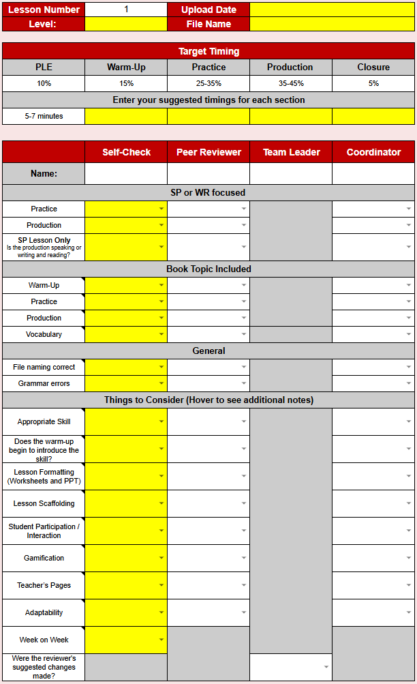
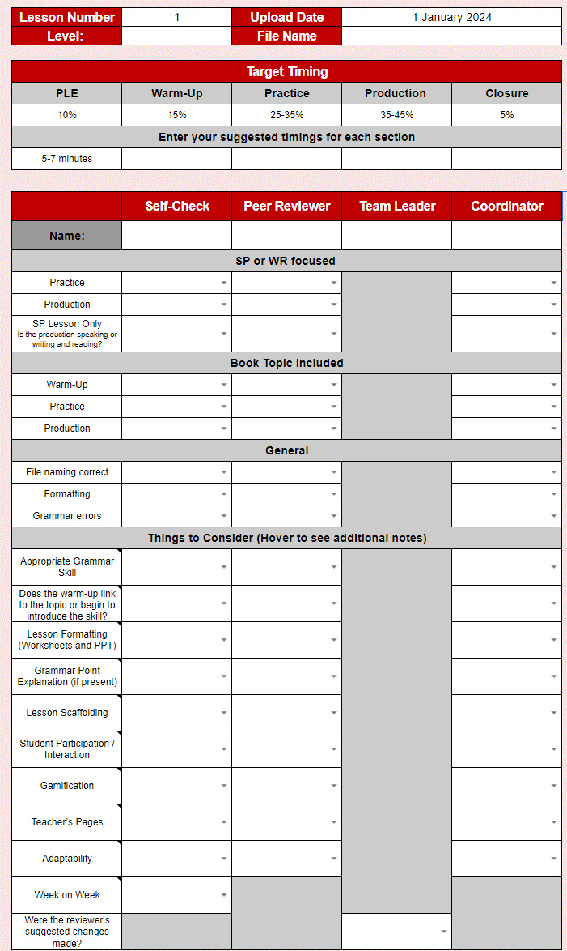
Lesson Feedback
New Teacher Lesson Feedback Form
This checklist is part of the new teacher training document on Google Sheets. During the training period, new teachers will receive more detailed feedback and comments each week.
Add the file name.
A reminder of target timing.
Enter your suggested timings for each section.
Add names as needed.
Complete the dropdown boxes in the self-check column.
Hover over these boxes to see additional notes.
After you have completed your self-check, your peer reviewer will complete their column.
After you and your reviewer have completed your columns, your team leader will complete their column.
The coordinator will then complete their section after your lesson is uploaded.
32

Slide 37
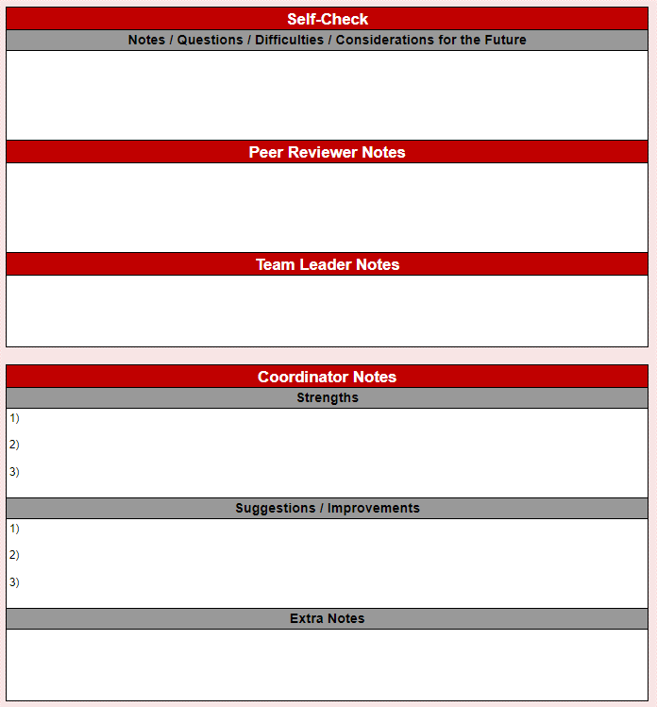
Lesson Feedback
New Teacher Lesson Feedback Form
A note box for any comments or questions you have.
Notes from your peer reviewer.
Notes from your team leader.
Comments from the coordinator of the level.
The coordinator will normally inform your team leader once they have completed your feedback. They might also contact you directly.
Communication
Please talk to your team leader more about this process before starting your first lesson. You can use the self-checklist when creating your lessons to help guide you in the right direction.
Please feel free to contact the relevant coordinator if you have more questions about lesson planning or the feedback that you receive.
33

